Slide 1
Time Series Analysis
Pauline Dang

Slide 2
What is TSA and what makes it special
A time series is a sequence of data in chronological order over a given time interval
A non-time series would represent data based off if the relation between 2 variables while a time series would represent data based off of time.
Ice cream sales projection.
Non-time series may have sales dependent of temperature
A time series would have sales dependent of time, maybe the time interval split up into the months of the year
A time series predicts data outside of the known data (extrapolation) based off of the known data
The further the times series predicts in the future, the larger the margin of error

Slide 3
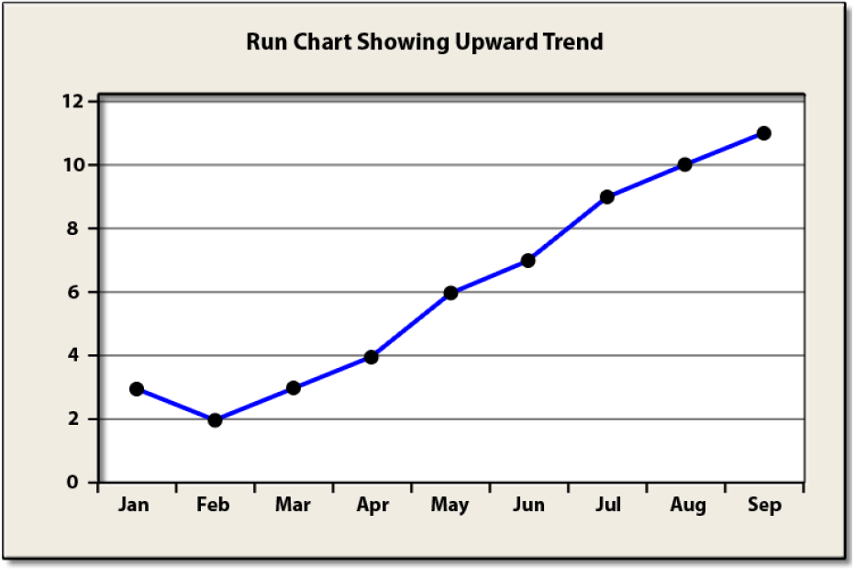
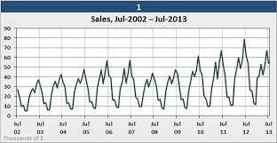
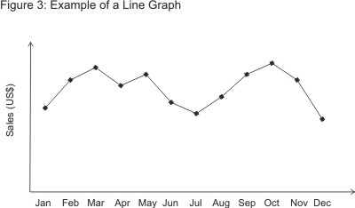
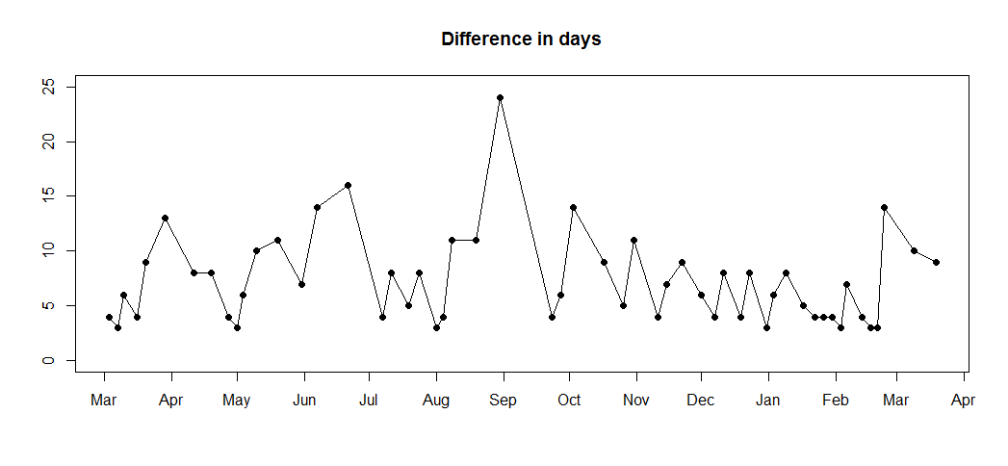
Components of Time Series Analysis
Trend
Seasonality
Cyclical
Irregularity

Slide 4
Stationary vs Non-Stationary Data
Stationary - A dataset that has no trend, seasonality, cyclical, and irregularity and:
The mean is constant
The variance is constant
The covariance is constant
Non-stationary data is data that breaks any of the rules of stationary data
For time series analysis, the data needs to be stationary, but there are various methods to make non-stationary data stationary
Removing the trend, unit root test, log transfer, etc

Slide 5
Moving Average Methodology
The Moving Average is the average of the different data within the period of time
Types
Simple Moving Average- The unweighted average of the data of a time interval
Cumulative Moving Average - The unweighted average of values form past to present
Exponential Moving Average - A weighted average of data where the weight of the data decreases and it goes further back.
Used to identify trends

Slide 6
TSA is Data Science and Machine Learning
Autocorrelation Function (ACF)
Used to indicate how similar a value is with the previous value
Measures the degree of the similarity between a given time series and the lagged version at different intervals
Partial Autocorrelation Function (PACF)
Shows the correlation of the sequence with itself with some number of time units per sequence order
Autoregressive Model
Predicts future performance based on past performance
It is a linear regression model that uses lagged variables as input

Slide 7
ARMA and ARIMA
ARMA is a combination of the autoregressive model and the moving average model
Best for predicting stationary series
ARIMA supports stationary and non-stationary data
Also uses the differencing of observation and makes stationary data

Slide 8
Introduction of Deep Learning
Deep learning is quite similar to machine learning
Machine learning has input and is classified using attributes that have been previously specified
Deep learning has input and is classified using a program that learns new attributes as you input more data.

Slide 9
Questions I Have
ACF vs PACF?
Applications of PACF?
When do I use PACF?

